Slide 1




Overview .Net Maui
Bruno targhetta
Development Consultant, Endava
@spinnaker_84
brunotarghetta
Notes:
@spinnaker_84

Slide 2
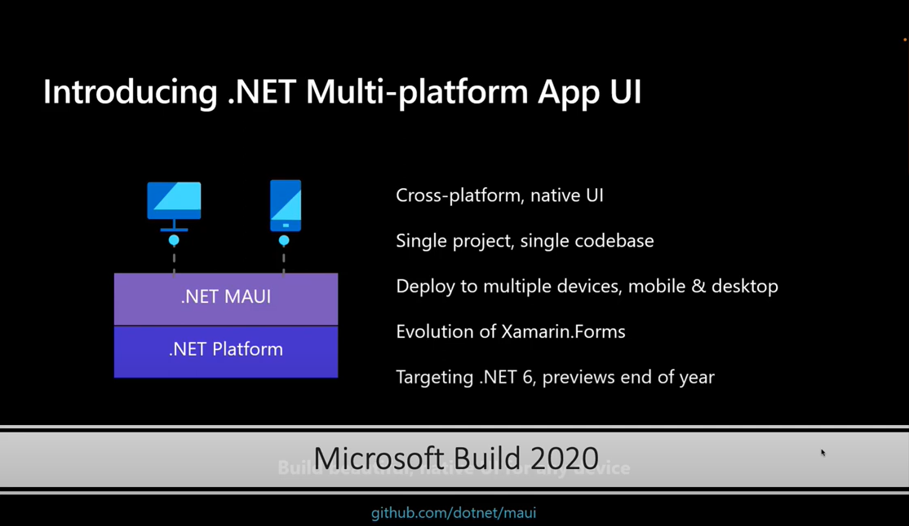
Notes:
Enero 2021 RC. Release candidates tuvo 14 previus. Hubo 3 reléase candidates (Soporte para Tizen) . 2022 Build anuncia General Availability

Slide 3


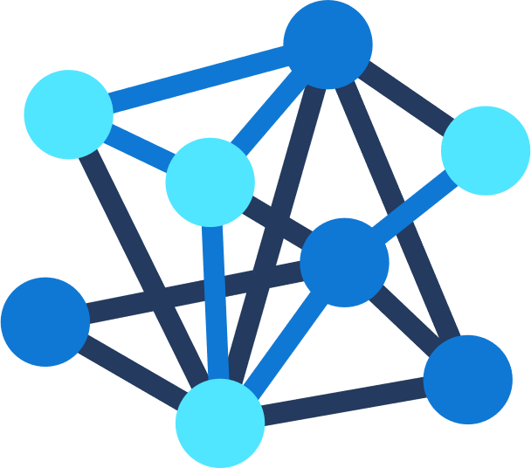





.NET – A unified development platform
ECOSYSTEM
TOOLS
NuGet
Visual Studio
CLOUD
WEB
DESKTOP
MOBILE
GAMING
IoT
AI
.NET 6
GitHub
Visual Studio for Mac
COMMON BASE LIBARIES/APIs
Components, tools, library vendors
Visual Studio Code
INFRASTRUCTURE
RUNTIME COMPONENTS
COMPILERS
LANGUAGES
CLI
Notes:
Unified Development platform. Cloud, IOT, Gaming, ETC. Net new every year.
C#, o pueden usar F# Funcional Language. Whatever they want.
25 años, free, open source, free for developers.
Let zoom on mobile (Win, Andoid, IOS) Target para esta charla.

Slide 4








Swift
Swift
JS
JS
iOS
iOS
JS
Swift
JS
JS
Swift
JS
JS
Java
.NET
JS
Java
C++
Java
C++
JS
Obj-C
Kotlin
Obj-C
Java
Obj-C
macOS
Kotlin
Kotlin
Obj-C
Kotlin
Notes:
Vast ecosystem and fwk and progmam language, some are cross platform, some enable to use simlar libraries. But there is a fragmentación (Java dev, Objetive c# dev)

Slide 5




iOS
iOS
macOS
.NET
.NET
.NET
.NET
.NET
.NET
.NET
.NET
.NET
.NET
.NET
.NET
.NET
.NET
.NET
.NET
.NET
.NET
.NET
.NET
.NET
.NET
.NET
.NET
.NET
.NET
.NET
.NET
.NET
.NET
.NET
.NET
.NET
.NET
.NET
.NET
.NET
.NET
.NET
.NET
.NET
.NET
.NET
.NET
.NET
Notes:
All develop in a single env. Net.

Slide 6


.NET MAUI App Architecture
C#
C#
C#
C#
Shared Code
UI, Resources, Platform Features, & Business Logic
Notes:
Net Maui: Open source, app platform from microsofht for building performant and multiplatform from a single a shared codebase.
Desde el punto de vista arquitectura:
Images, Font, are shared, BussinesLogic (ViewModel, Controller, services)
Acces to underline API from IOS, Android, WIN

Slide 7




Productive environment
Maximize code reuse
Native performance & integrations
Expansive ecosystem
Notes:
Entonces las ventajas son estas:
Productive environment: Visual Studio 2022 (Copilot, remote Debugging, hot reload) , Connect to IOS to debug app. (Pair Mac)

Slide 8
Cross-Platform UI
Notes:
How is render on different platform

Slide 9



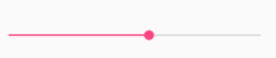
UIActivityIndicator
ProgressBar
UISlider
SeekBar
ActivityIndicator
Slider
Notes:
Activity Indicator: es una api qu renderiza los controler nativos.

Slide 10
Controls
CarouselView
CollectionView
ListView
Picker
TableView
IndicatorView
ProgressBar
ActivityIndicator
Editor
Entry
CheckBox
DatePicker
Slider
Stepper
Switch
TimePicker
Button
ImageButton
RadioButton
RefreshView
SearchBar
SwipeView
BlazorWebview
Border
BoxView
Frame
GraphicsView
Image
Label
ScrollView
Notes:
Tons of different controls.

Slide 11

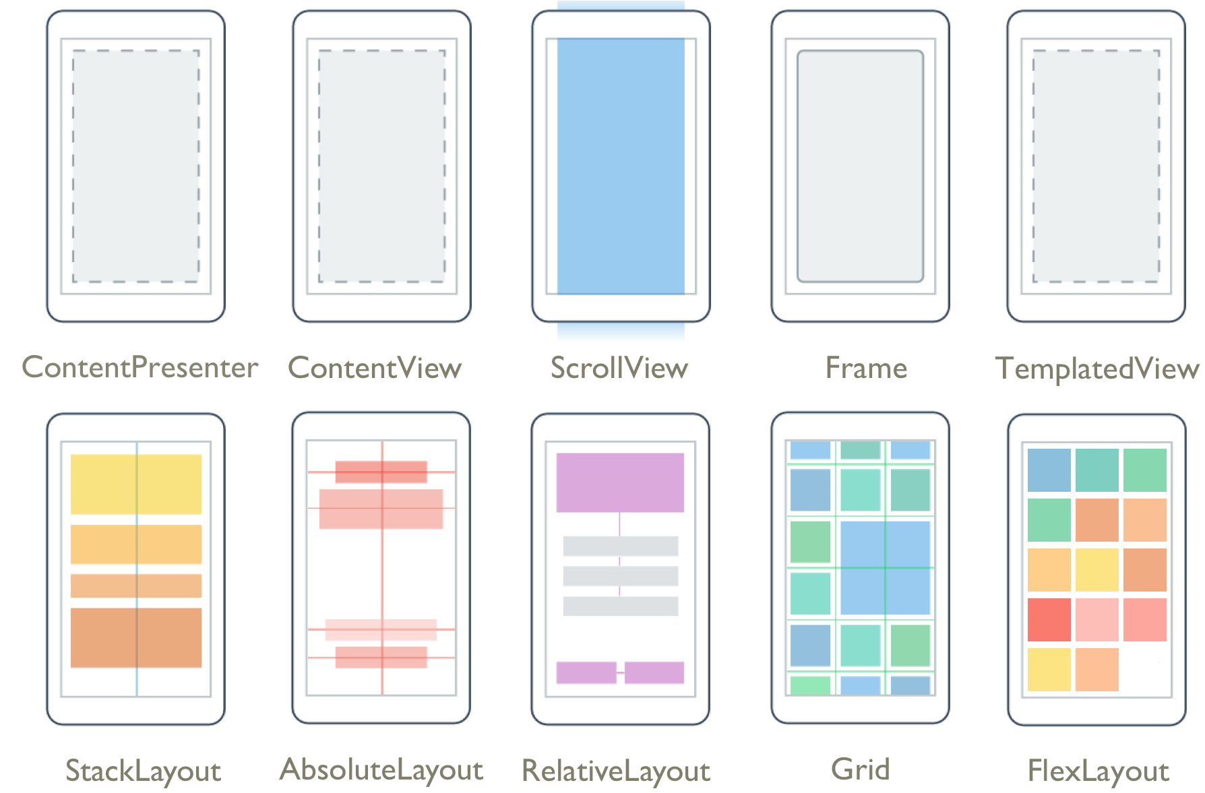
Layouts
Pages
Content
Flyout
Navigation
Tabbed
Notes:
Types of pages.
Layout is how control are render. Page are divided.

Slide 12
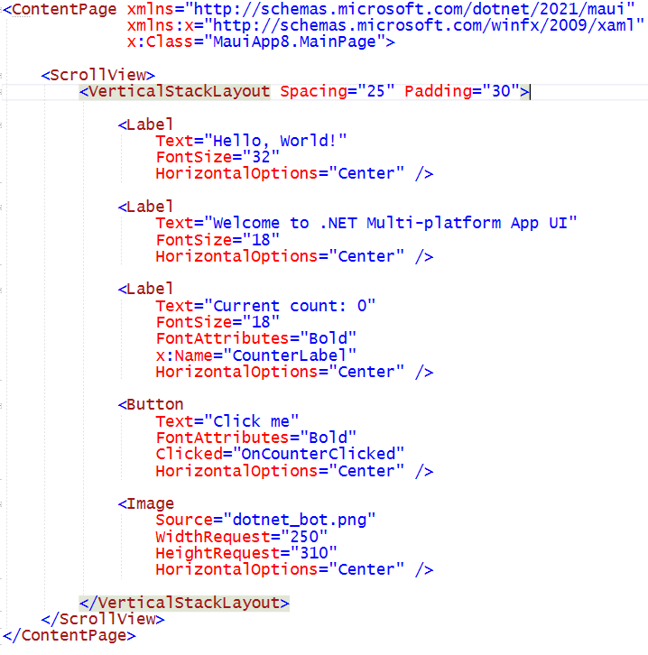
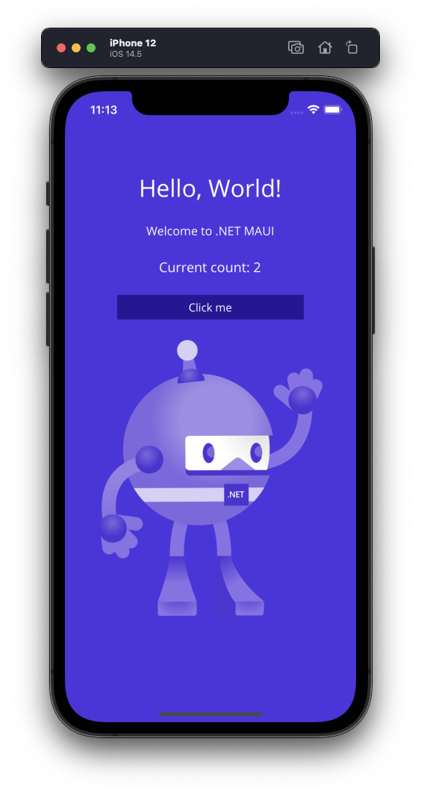
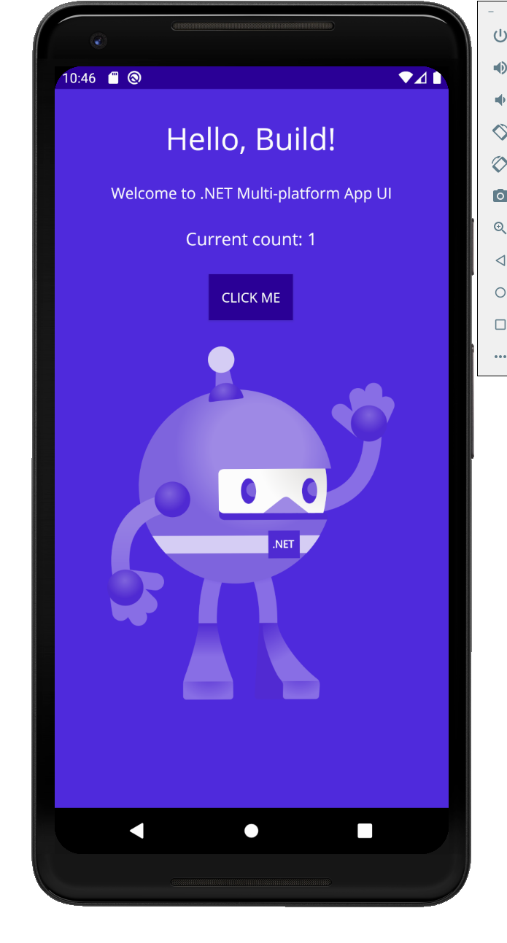
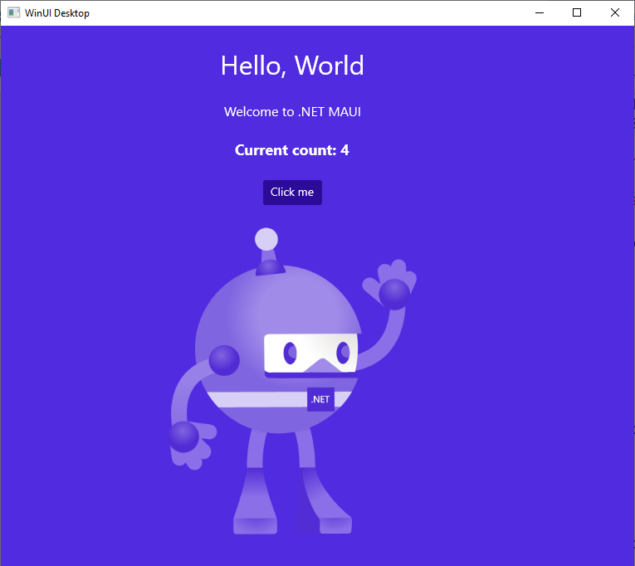
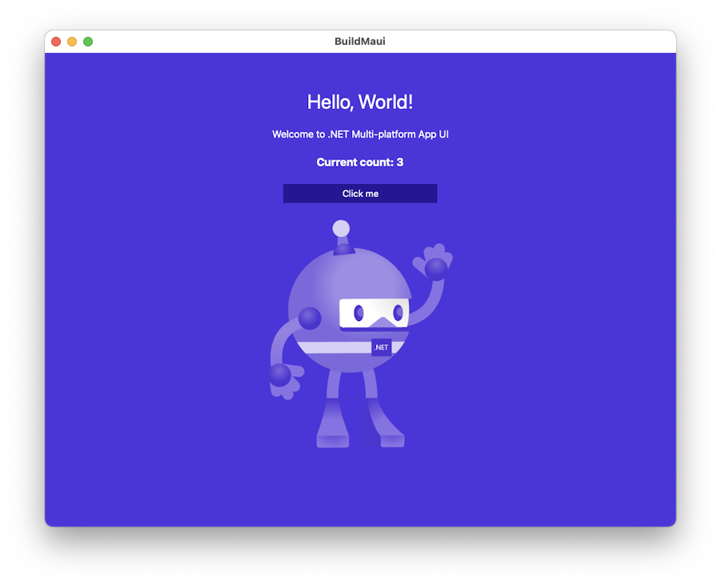
Notes:
XML marckup. How is generated on IOS, MAC, Android and Windows.

Slide 13

Cross-Platform APIs
Sms
Secure Settings
Preferences
Flashlight
Clipboard
Gyroscope
Magnetometer
Geolocation
Phone Dialer
Device Display Info
Email
Device Info
Battery
Compass
Accelerometer
Screen Lock
Data Transfer
Text to Speech
Geocoding
File System
Connectivity
Vibration
Notes:
Bunch of API that can use. All API are available on C# single api.

Slide 14
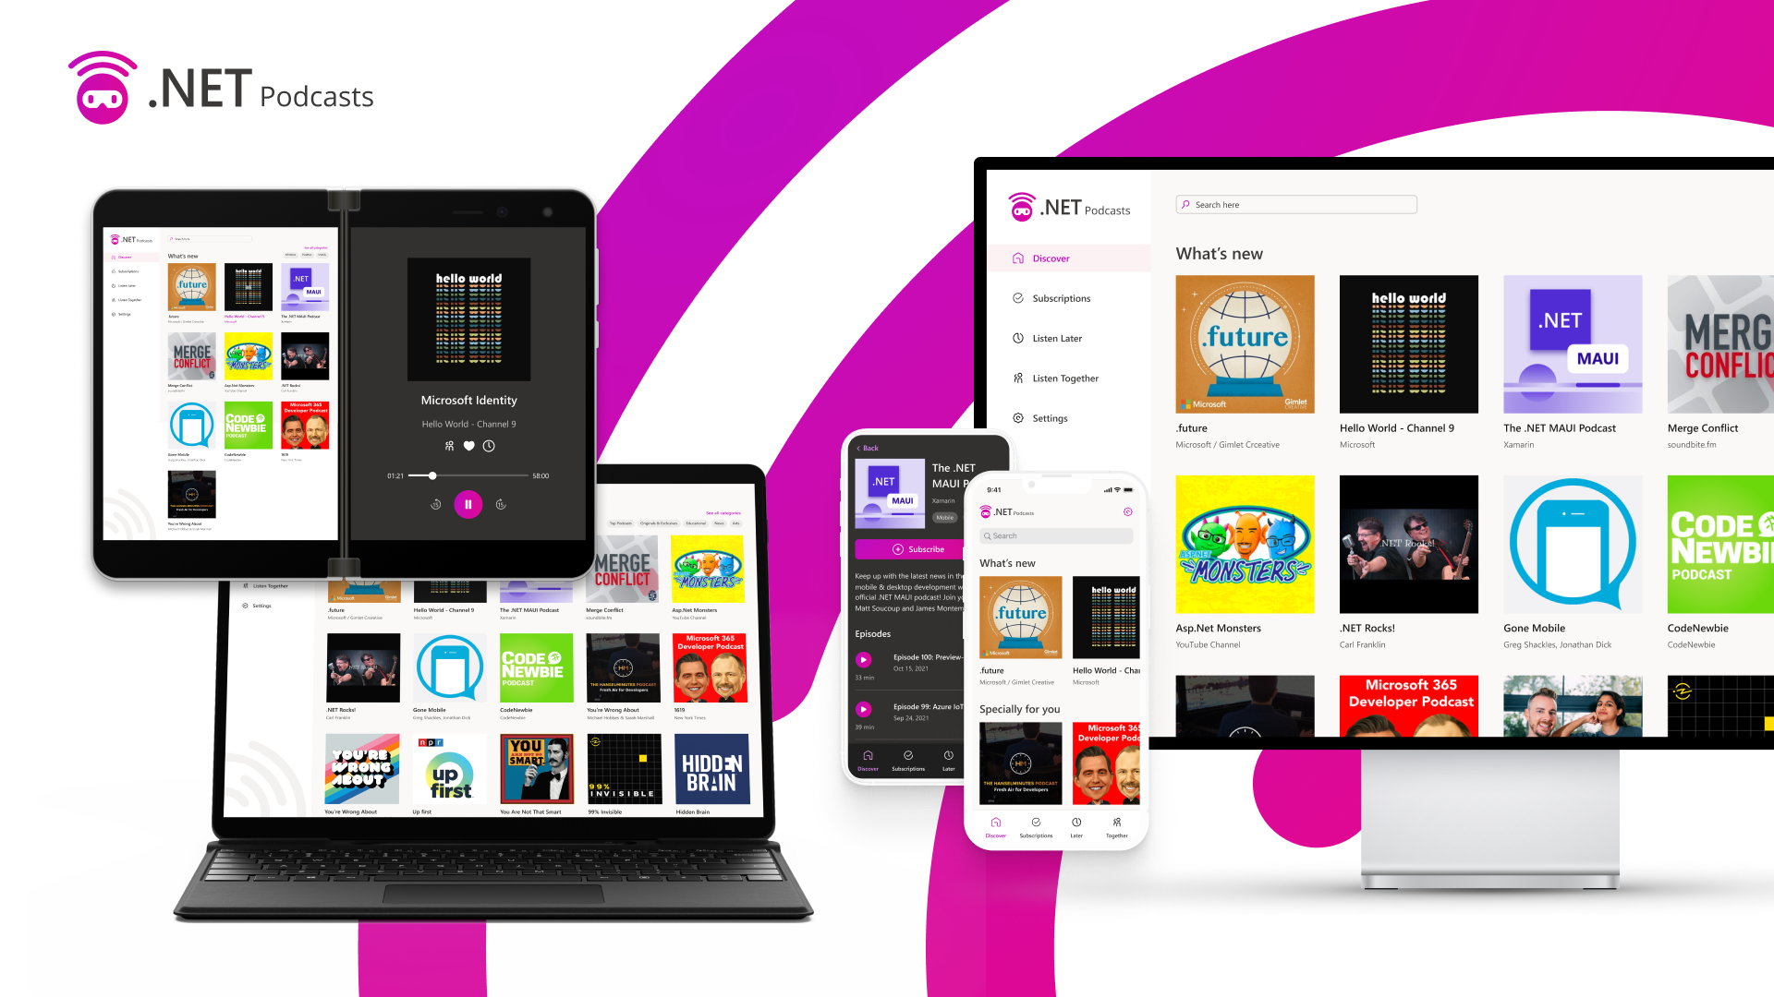

Slide 15
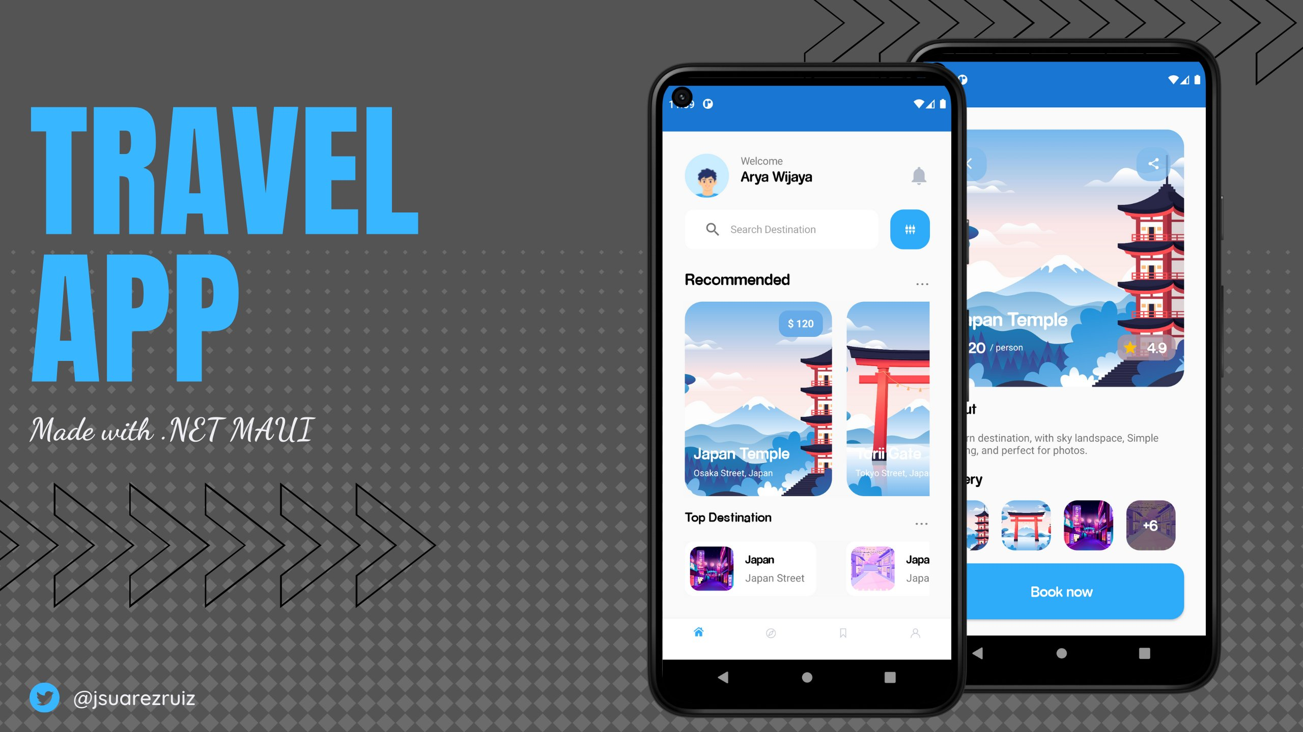

Slide 16
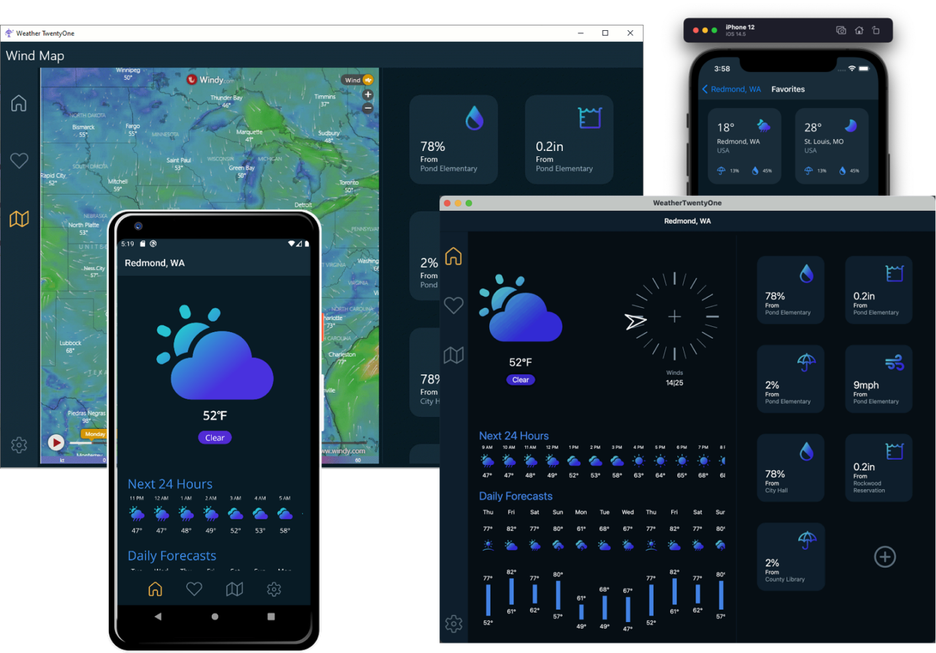

Slide 17
What about web developers?
Notes:
If you are a web developer?

Slide 18








Web development with .NET
ASP.NET Core
Blazor
JS
Notes:
Web you can do aspnetCore and link to JS app (angular, react)
Or connect to Blazor. You dont have to write code on Js.

Slide 19



Blazor is flexible. You have choices.
Blazor Server
Blazor WebAssembly
Blazor
Blazor
DOM
SignalR
.NET
Razor Components
DOM
.NET
Razor Components
WebAssembly
Notes:
There two models.
Blazor Server: Signal R
WebAssembly: execute your code in the browser.

Slide 20














Blazor
Notes:
Blazor web, net maui mobile:

Slide 21




Blazor Hybrid:
+
Notes:
A la unión le dicen blazor hybrid. Share your blazor controller insight in a net maui Project.

Slide 22
.NET brings rich choices for devs and dev teams
Blazor
Blazor Hybrid
(Blazor + .NET MAUI)
.NET MAUI
Reach
Power
Site
PWA
Native App
with WebView
Native App
Web
Hybrid
Native

Slide 23
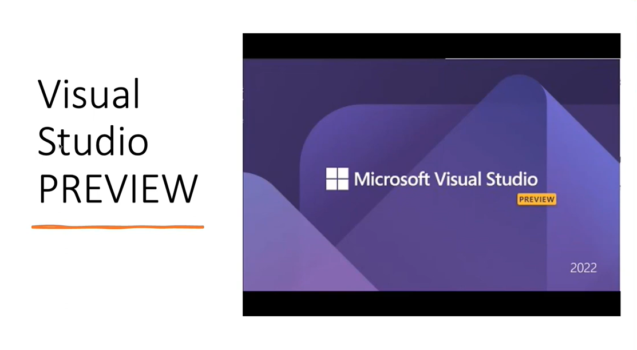
Notes:
Contras: GA. In visual studio Preview.

Slide 24
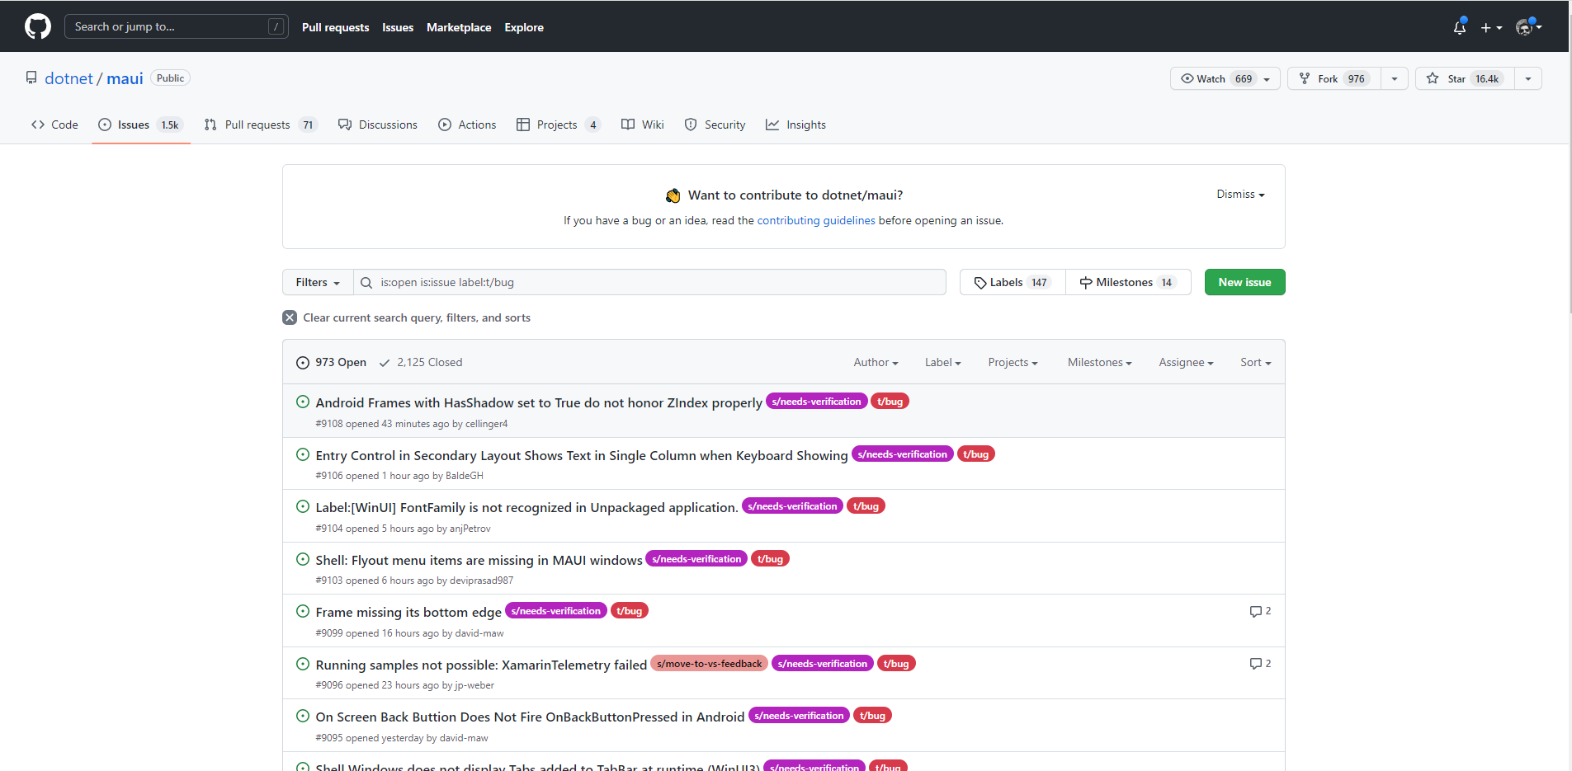
Maui Today
Notes:
Issues abiertas - 1500 → Filtro por bugs y tengo 973. Parece un poco mucho. https://github.com/dotnet/maui/issues?q=is%3Aopen+is%3Aissue+label%3At%2Fbug.
En Noviembre sale Net 7. Esperaria ahí. Con Xamarin Forms paso lo mismo. Y realmente fui un buen producto.

Slide 25

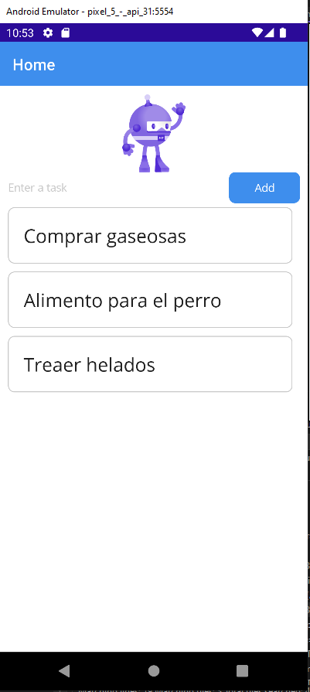
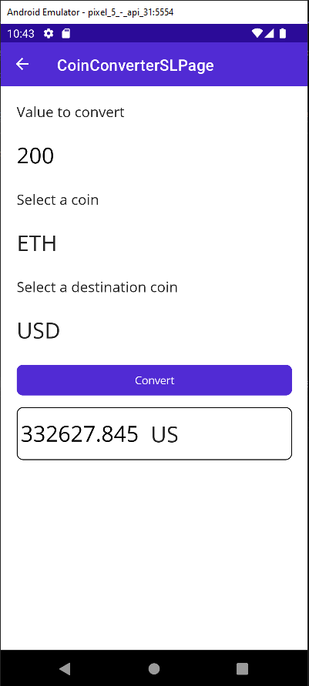
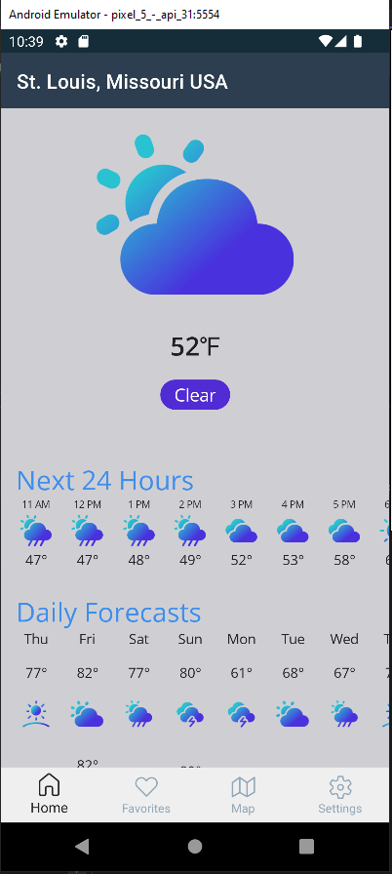
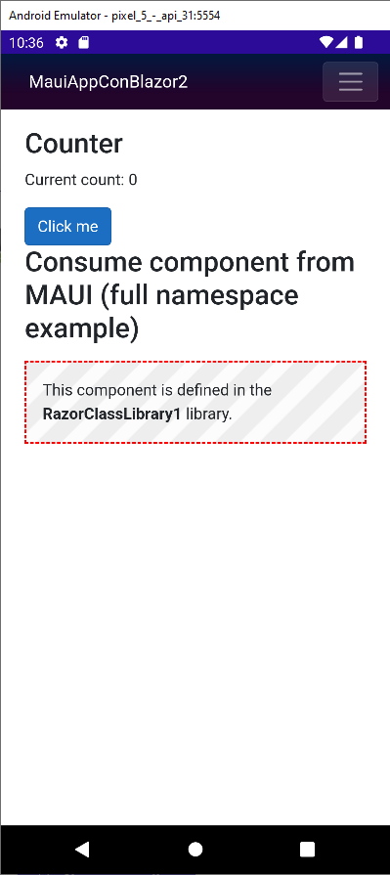
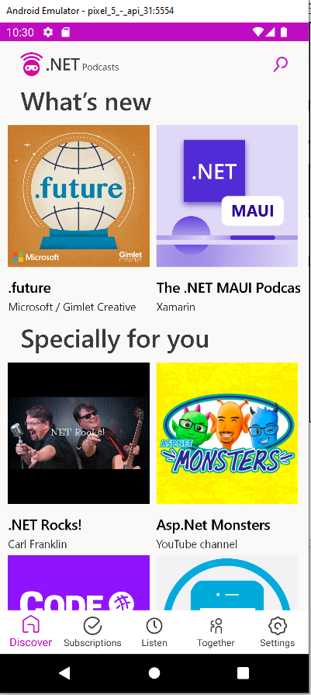
Mobile Community - Conociendo Xamarin Forms
Demo
Notes:
Demo:
TODO Task
Mostrar esquema
Main Detail - Navegacion
Inyeccion - Connectivity
CoinConverter
Service
Shell
Property para android
Weather
Estilos
MauiConBlazorApp2
Blazor app web
Mobile
Componente compartido.
Despues Podcast
App Maui
App Maui.Blazor

Slide 26




Mobile Community - Net Maui
Resources
.NET MAUI: https://dotnet.microsoft.com/apps/mau...
.NET MAUI Workshop: https://github.com/dotnet-presentatio...
.NET MAUI Docs: https://docs.microsoft.com/dotnet/mau...
.NET MAUI Samples: https://github.com/dotnet/maui-samples
Notes:
Standard text slide (version 1)
Use standard text slides as little as possible. They can be used for an introduction to a presentation, summary of work, detailed legal information.
All presentations should be a mix of text-heavy pages and visual pages.
In a presentation, choose between 1, 2, or 3 column text pages to be consistent within the document.

